Slide 1
Process and Program
Delivered by Jinghao

Slide 2
Process and Program
🤔
A program is static, including instructions and data, all of which are stored in an executable file.
A process is a running instance of a program, including states such as CPU allocation, PCB and program counter…
Analogy: A company allocates tasks to workers. Each task can be considered as a program, it defines what to do. Which worker (cpu) picks up the task, how the worker handles the task (memory, registers …) are considered a process.
💡

Slide 3
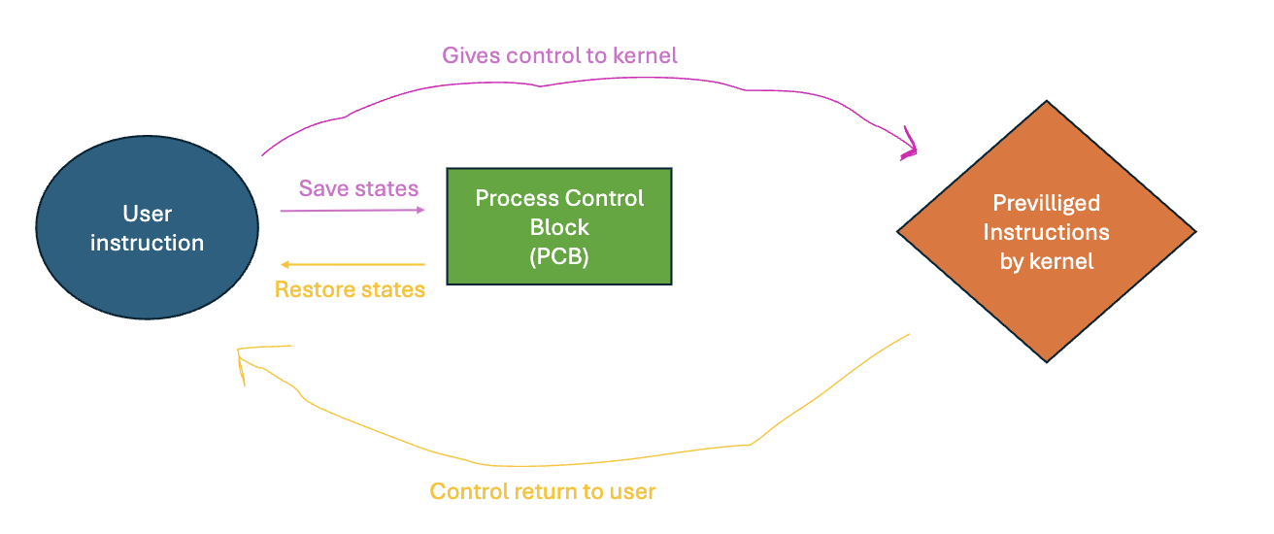
PCB – Process Control Block
Everything the kernel needs to know about a process is stored here.

Slide 4
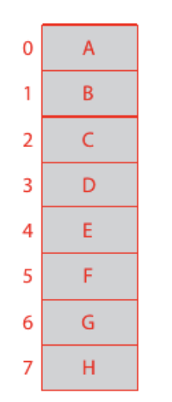
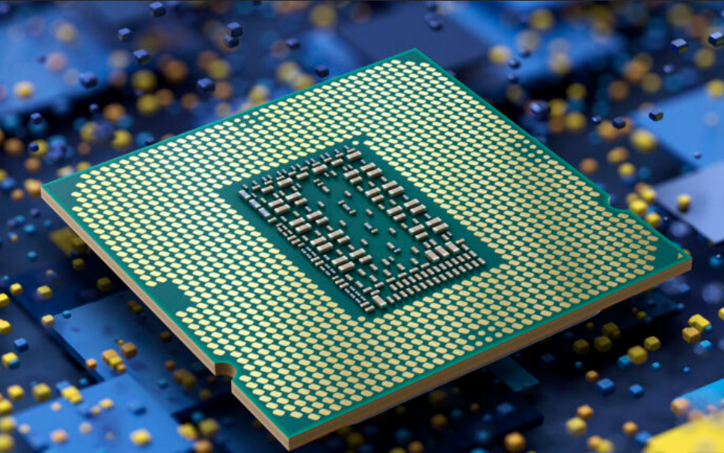
Creating a process
Allocate kernel bookkeeping and address space (Do we allocate virtual or physical memory? Demand Paging)
Establish initial resource like stdin stdout and stderr
Initialise registers
Process now ready to go (place in queue awaiting schedule)
- A CPU is shared between processes
- Memory is also shared isolated !
Threads: workers of a process, does a portion of work within a process

Slide 5
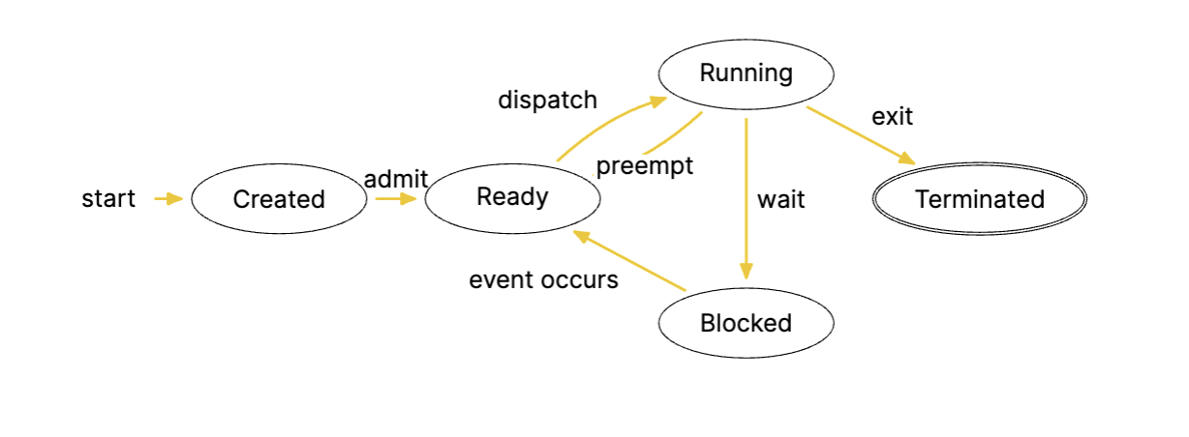
Lifecycle of a process

Slide 6



Different process creation interface
Windows: CreateProcess
Posix: fork + exec
❓
Where is ‘fork’ coming from?

Slide 7




Fork()
Return -1: creation failed
Return 0: in the child process
Return >0: in the parent process
Parent
Execution order not guaranteed without synchronization!
Copy on Write
Parent
Child
Memory is isolated shared at this instance! This sharing persists until the child attempts to change the parent memory.
Mmap()?

Slide 8

Execve()
Child call execve() to execute another program after creation. No later code (which is from the parent) after execve() will be executed.
Returns -1 if failed, no return if success.
Shell uses fork + exec
Difference between exec and execve?
💡
One is library function and another is system call

Slide 9
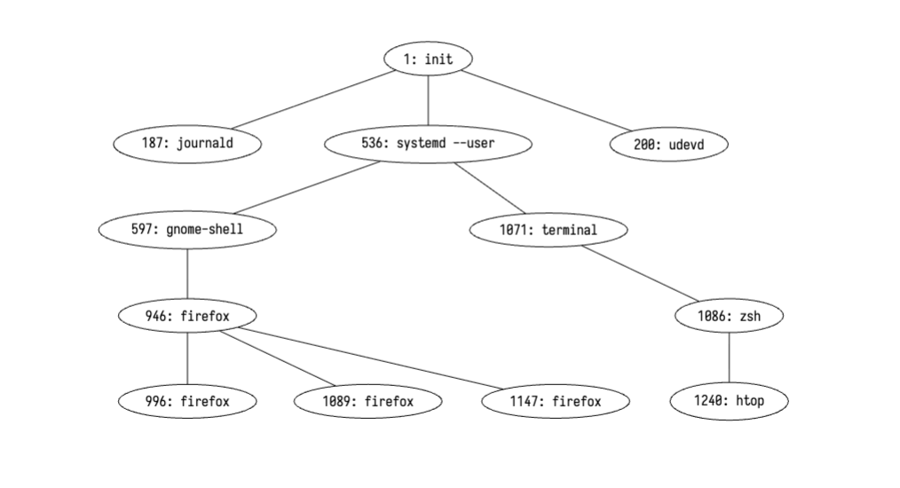
Processes after creation
Every process has a parent, their relationship can be drawn as a tree. Each process has its unique identifier pid.

Slide 10



Process after execution
Returns exit status (how the process exits: Success? Err? Killed?)
Parent collects these information by calling wait() or waitpid(). The parent is blocked if the child is still running while it calls wait.
getppid()
Get assigned a parent
Zombie: Finish before parent calls wait()
Orphan: Parent exit without calling wait()

Slide 11

How do processes communicate?

Slide 12
Pipe
One sender; one receiver
Byte stream
Regular (Parent and child)
Named (processes)
Signal (kenel to process)

Slide 13

pipe(fd); int fd[2]
pipe[fd] returns file descriptors only to the calling process
A fork creates a child that inherits these descriptors
One is a read end and another is a write end. (Why?)
Idea: Imagine these two kids speak the same time

Slide 14
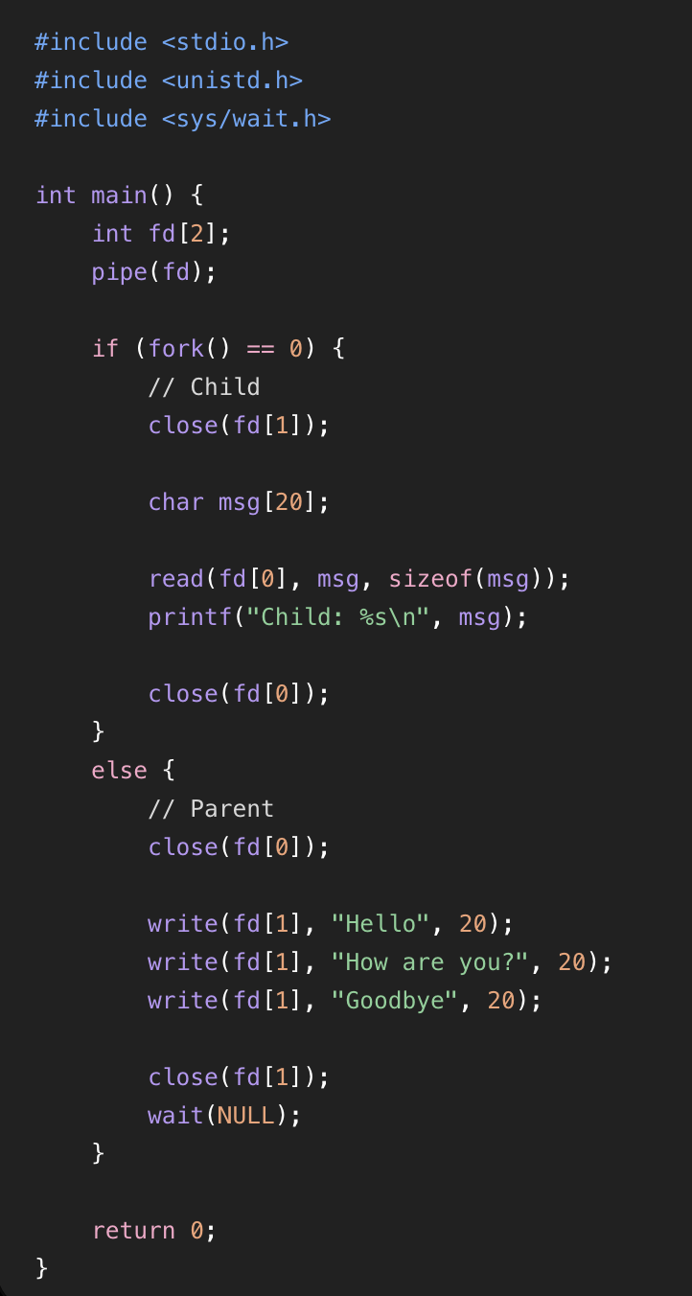
What will be printed?
A) Hello How are you? Goodbye
B) Hello

Slide 15
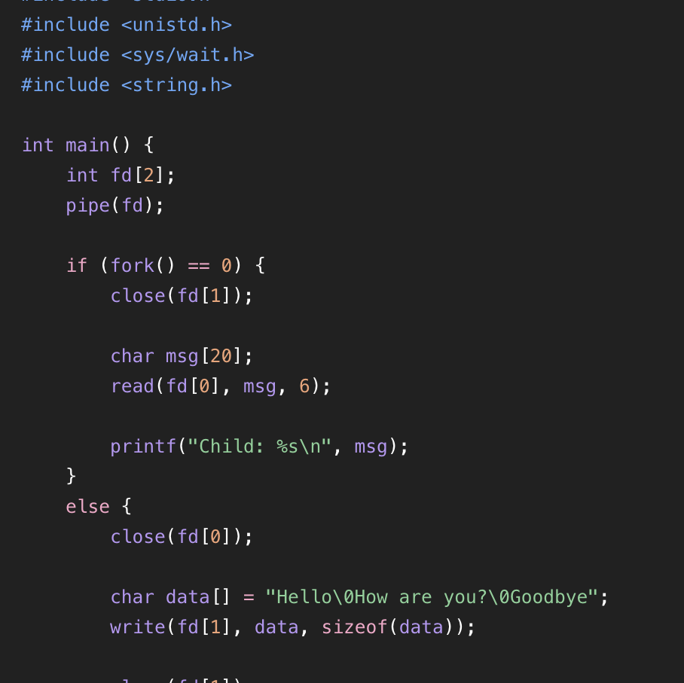
How about this?
A) Hello\0How are you?\0Goodbye
B) Hello\0
C) Hello

Slide 16

Unrelated process communication
mkfifo(const char *pathname, mode_t mode) makes a named pipe
int fd = open(“pathname”, O_RDONLY) reads from the pipe
int fd = open (“pathname”, O_WRONLY) writes to the pipe
Blocking may happens if one end is opened but the other end is still awaiting a process.

Slide 17

Kernel’s message to user process
Kernel sends signal to user process, user process upon these signals: accept default behaviour/ignore/define handling
Events (ctrl + c, invalid memory access, child terminates, preemption) cause the kernel to deliver a signal

Slide 18

Attendance

